Slide 1
~ Roots of Equations ~ Bracketing Methods Chapter 5
Credit: Prof. Lale Yurttas, Chemical Eng., Texas A&M University

Slide 2
Roots of Equations
Easy
But, not easy
How about these?

Slide 3
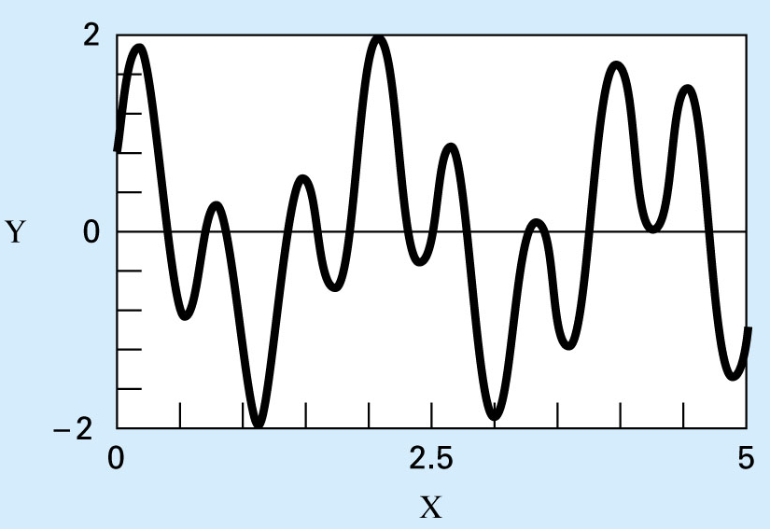
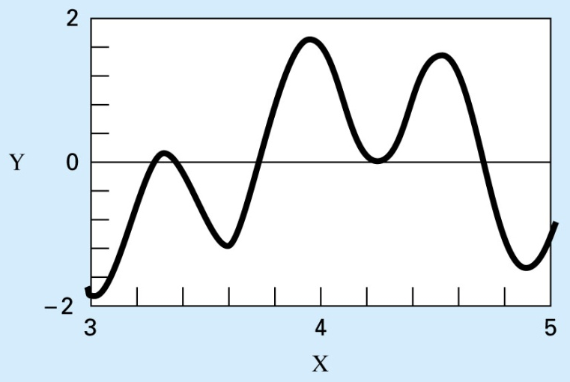
Graphical Approach
Make a plot of the function f(x) and observe where it crosses the x-axis, i.e. f(x) = 0
Not very practical but can be used to obtain rough estimates for roots
These estimates can be used as initial guesses for numerical methods that we’ll study here.
Using MATLAB, plot f(x)=sin(10x)+cos(3x)
Two distinct roots between
x= 4.2 and 4.3
need to be careful

Slide 4
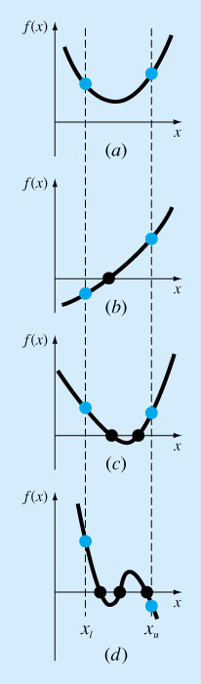
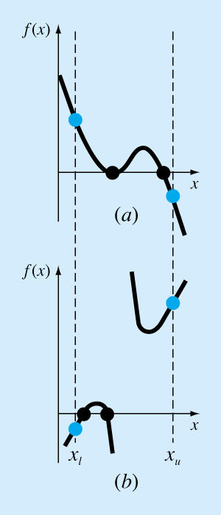
exceptions
Bracketing:
Odd and even number of roots

Slide 5
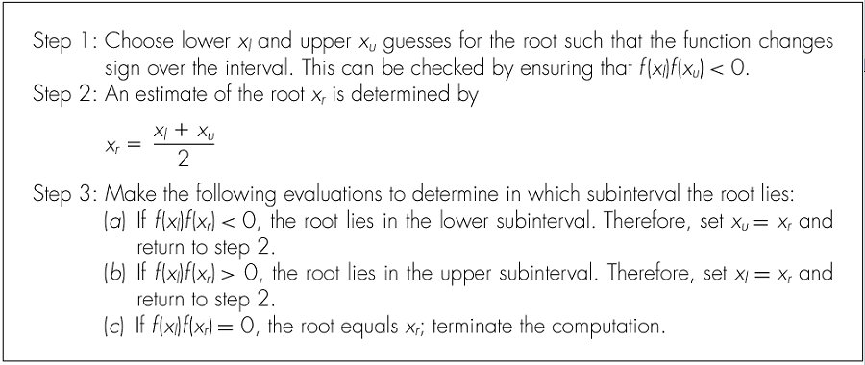
Bisection Method
Termination criteria: ε < ε_{tol} OR Max.Iteration is reached

Slide 6
MATLAB code Bisection Method
% Bisection Method
% function is available in another file e.g. func1.m
% A sample call: bisection2(@func1, -2, 4, 0.001, 500)
function root = bisection(fx, xl, xu, es, imax);
if fx(xl)*fx(xu) > 0 % if guesses do not bracket
disp('no bracket')
return
end
for i=1:1:imax
xr=(xu+xl)/2
ea = abs((xu-xl)/xl);
test= fx(xl)*fx(xr);
if test < 0
xu=xr;
end
if test > 0
xl=xr;
end
if test == 0
ea=0;
end
if ea < es
break;
end
end
Minimize function evaluations in the code.
Why?
Because they are costly (takes more time)

Slide 7
How Many Iterations will It Take?
Length of the first Interval L_{o}= x_{u}- x_{l}
After 1 iteration L₁=L_{o}/2
After 2 iterations L₂=L_{o}/4
….. …..
After k iterations L_{k}=L_{o}/2^{k}
Then we can write:

Slide 8
*here Bisection Method
Pros
Easy
Always finds a root
Number of iterations required to attain an absolute error can be computed a priori.
Cons
Slow
Need to find initial guesses for x_{l} and x_{u}
No account is taken of the fact that if f(x_{l}) is closer to zero, it is likely that root is closer to x_{l} .

Slide 9
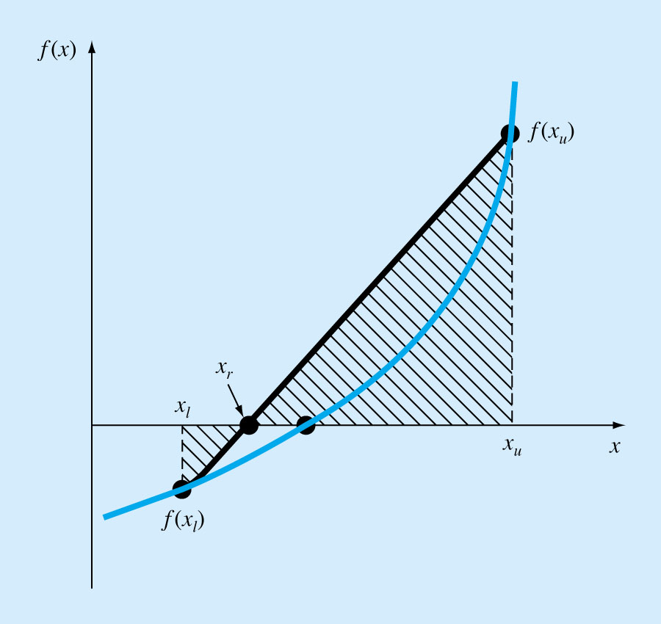
The False-Position Method (Regula-Falsi)
We can approximate the solution by doing a linear interpolation between f(x_{u}) and f(x_{l})
Find x_{r} such that l(x_{r})=0, where l(x) is the linear approximation of f(x) between x_{l} and x_{u}
Derive x_{r} using similar triangles

Slide 10
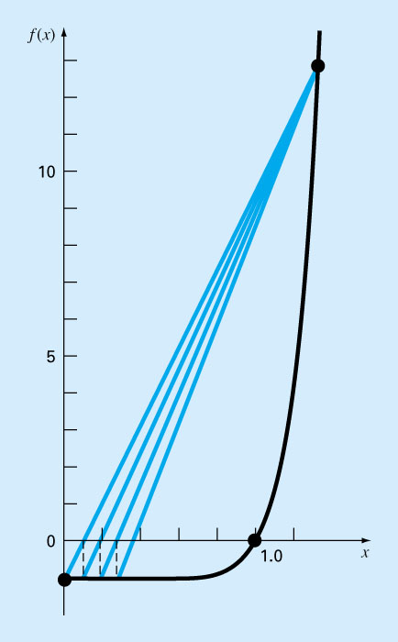
The False-Position Method
Works well, but not always! ⬅⬅ Here is a pitfall ☹
Modified False-Position
One way to mitigate the “one-sided” nature of the false position (i.e. the pitfall case) is to have the algorithm pick the smallest bracket (between the Bisection Method & this one)

Slide 11
How to find good initial guesses?
Start at one end of the region of interest (x_{a}) and evaluate
f(x_{a}), f(x_{a}+Δx), f(x_{a}+2Δx), f(x_{a}+3Δx), ........
Continue until the sign of the result changes.
If that happens between f(x_{a}+k*Δx) and f(x_{a}+(k+1)*Δx)
then pick x_{l}= x_{a}+k*Δx and x_{u}= x_{a}+(k+1)*Δx
Problem:
if Δx is too small ➔ search is very time consuming
if Δx is too large ➔ could jump over two closely spaced roots
Suggestions:
Generate random x values and evaluate f(x) each time until you find two values that satisfy f(x1)*f(x2) < 0
Know the application and plot the function to see the location of the roots, and pick x_{l} and x_{u} accordingly to start the iterations.

